Slide 1

Understanding Equity
GNED 500
Week 10
Photo by fauxels from Pexels
Notes:
Understanding Equity

Slide 2
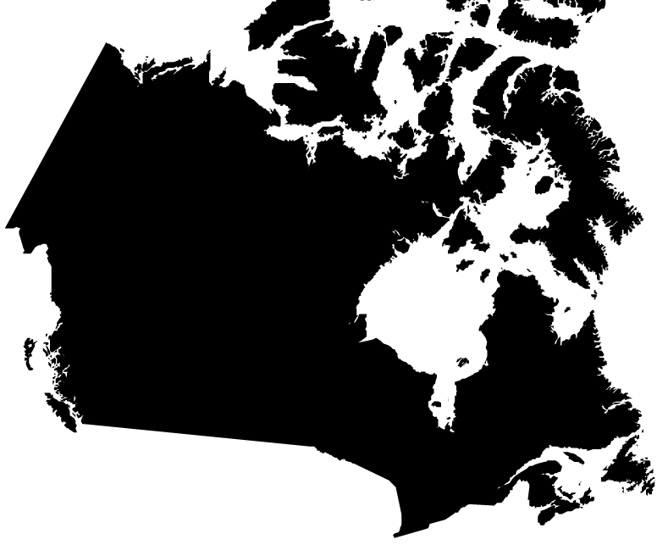
Acknowledgement
Traditional Lands
Canada Map Vectors by Vecteezy
Notes:
Acknowledgement of Traditional Lands
Centennial is proud to be a part of a rich history of education in this province and in this city.
We acknowledge that we are on the treaty lands and territory of the Mississauga’s of the Credit First Nation and pay tribute to their legacy and the legacy of all First Peoples of Canada, as we strengthen ties with the communities we serve and build the future through learning and through our graduates.
Today the traditional meeting place of Toronto is still home to many Indigenous People from across Turtle Island and we are grateful to have the opportunity to work in the communities that have grown in the treaty lands of the Mississauga’s.
We acknowledge that we are all treaty people and accept our responsibility to honor all our relations

Slide 3
AGENDA
Understanding Equity & Equality
Meritocracy
Deficit Thinking
Social Inequality
Indigenous People
Indigenous or Aboriginal
Treaty Rights
Treaties
The Indian Act
Residential Schools
The 60’s Scoop
The Millennial Scoop
Truth & Reconciliation
UNDRIP
Questions
Artwork by Hi Profile is licensed under a CC BY-NC-SA 4.0 International License.
Notes:
Understanding Equity & Equality
Meritocracy
Deficit Thinking
Social Inequality
Indigenous People
Indigenous or Aboriginal
Treaty Rights
Treaties
The Indian Act
Residential Schools
The 60’s Scoop
The Millennial Scoop
Truth & Reconciliation
UNDRIP
Questions

Slide 4

LEARNING OUTCOMES
At the end of this session, you should be able to:
Differentiate between equity and equality
Understand the roots of colonialism and how it leads to internalized colonization
Examine the issue of race in relation to equity
Understand deficit thinking, meritocracy, neoliberalism, and tokenism
Recognize that power and privilege are contextual
LEARNING
OUTCOMES
Vector by pch.vector - freepik.com
Notes:
Students will learn and reliably demonstrate the ability to:
Differentiate between equity and equality
Understand the roots of colonialism and how it leads to internalized colonization
Examine the issue of race in relation to equity
Understand deficit thinking, meritocracy, neoliberalism, and tokenism
Recognize that power and privilege are contextual

Slide 5

Understanding Equity and Equality
If we understand equity as who gets what, when, and how (Frick, Parsons, & Frick, 2019), we will better understand how during a pandemic.
For instance, some groups have more access to resources, supports, networks, and opportunities than others
Vector by pch.vector - freepik.com
Notes:
If we understand equity as who gets what, when, and how (Frick, Parsons, & Frick, 2019), we will better understand how during a pandemic.
For instance, some groups have more access to resources, supports, networks, and opportunities than others

Slide 6
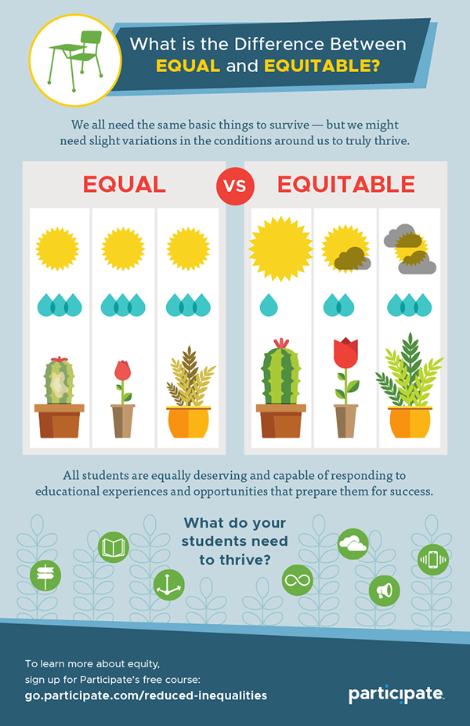
Understanding Equity and Equality
Many factors produce inequality, Certain groups and individuals have advantages over others that give them access to opportunity.
In other words, our society is not a level playing field.
How do we address social inequality?
Infographic by Jim Kennedy
Notes:
Many factors produce inequality, Certain groups and individuals have advantages over others that give them access to opportunity.
In other words, our society is not a level playing field.
How do we address social inequality?

Slide 7
Equality
One way of addressing social inequalities is to insist on the same treatment for everyone.
Equality denotes sameness – everyone is treated the same without consideration of individual needs, circumstances, background or history.
But is equality always fair?
Image by Jim Kennedy
Notes:
One way of addressing social inequalities is to insist on the same treatment for everyone.
Equality denotes sameness – everyone is treated the same without consideration of individual needs, circumstances, background or history.
But is equality always fair?

Slide 8
Equity
Treating people equally in all cases can preserve inequality because, in most societies, individuals do not possess equal access to opportunities and resources in the first place.
In other words, we live in societies where we do not start off as equal and where we do not all have the same chances.
This is why equity continually asks the question: What is fair?
Our answers will vary depending on our values, ideologies, and location in society.
Equity: a concept that promotes the treatment of individuals taking into consideration circumstances, experiences, background, and history. Equity is focused on achieving equality of outcomes.
There are different transit fares for students, seniors, and adults. Why is this? Is this fair?
Image by Jim Kennedy
Notes:
Treating people equally in all cases can preserve inequality because, in most societies, individuals do not possess equal access to opportunities and resources in the first place.
In other words, we live in societies where we do not start off as equal and where we do not all have the same chances.
This is why equity continually asks the question: What is fair?
Our answers will vary depending on our values, ideologies, and location in society.
Equity: a concept that promotes the treatment of individuals taking into consideration circumstances, experiences, background, and history. Equity is focused on achieving equality of outcomes.
There are different transit fares for students, seniors, and adults. Why is this? Is this fair?

Slide 9
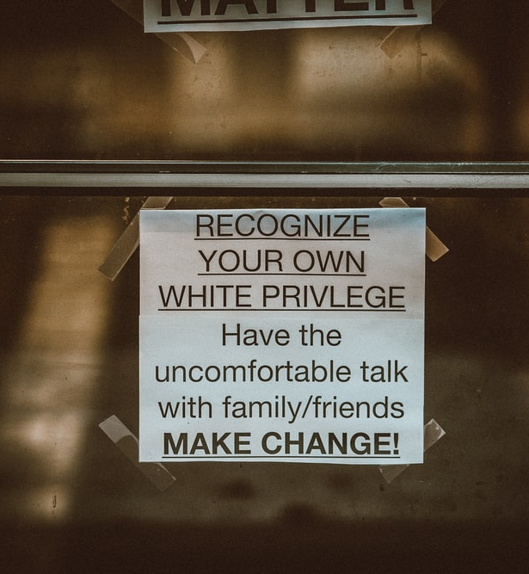
WHITE PRIVILEGE
Taken-for-granted power and a system of benefits, advantages, and opportunities experienced by white persons simply because of the colour of their skin.
Photo by Jon Tyson on Unsplash

Slide 10
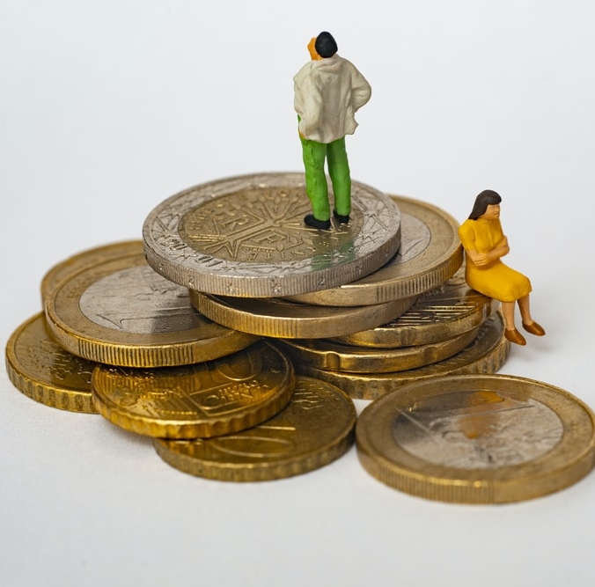
MERITOCRACY
A social order where people are ranked and rewarded based on their abilities with no consideration of contextual factors that may affect their performance (DeSario, 2003, p. 485).
Photo by Mathieu Stern on Unsplash
Notes:
A social order where people are ranked and rewarded based on their abilities with no consideration of contextual factors that may affect their performance (DeSario, 2003, p. 485).

Slide 11
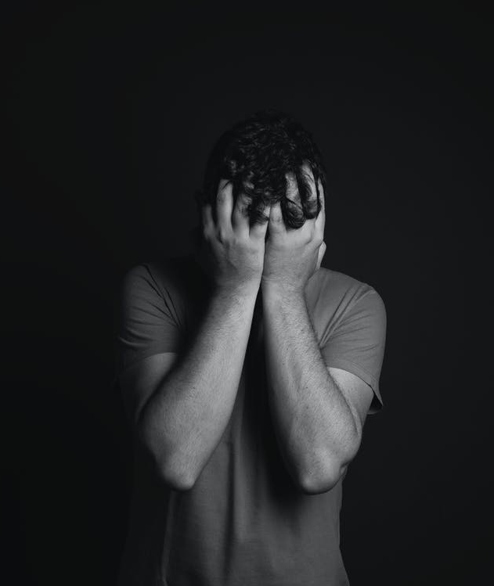
Deficit Thinking
Focuses on what students “lack” and aims to “fix” them, while ignoring or minimizing the structural and systemic issues that affect their lives and learning experiences.
It looks for simple answers to complex issues like racism, sexism, and classism.
Deficit thinking strengthens stereotypes, discourages students, leads to low expectations of students, and has a negative impact on students’ overall education
Photo by Daniel Reche from Pexels

Slide 12
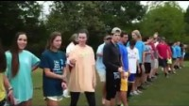
SOCIAL INEQUALITY
Notes:
https://youtu.be/4K5fbQ1-zps

Slide 13

BREAK
Photo by Angela Roma from Pexels.com
Notes:
15 Minute Break
This slide can be moved to where you have your class break(s)

Slide 14
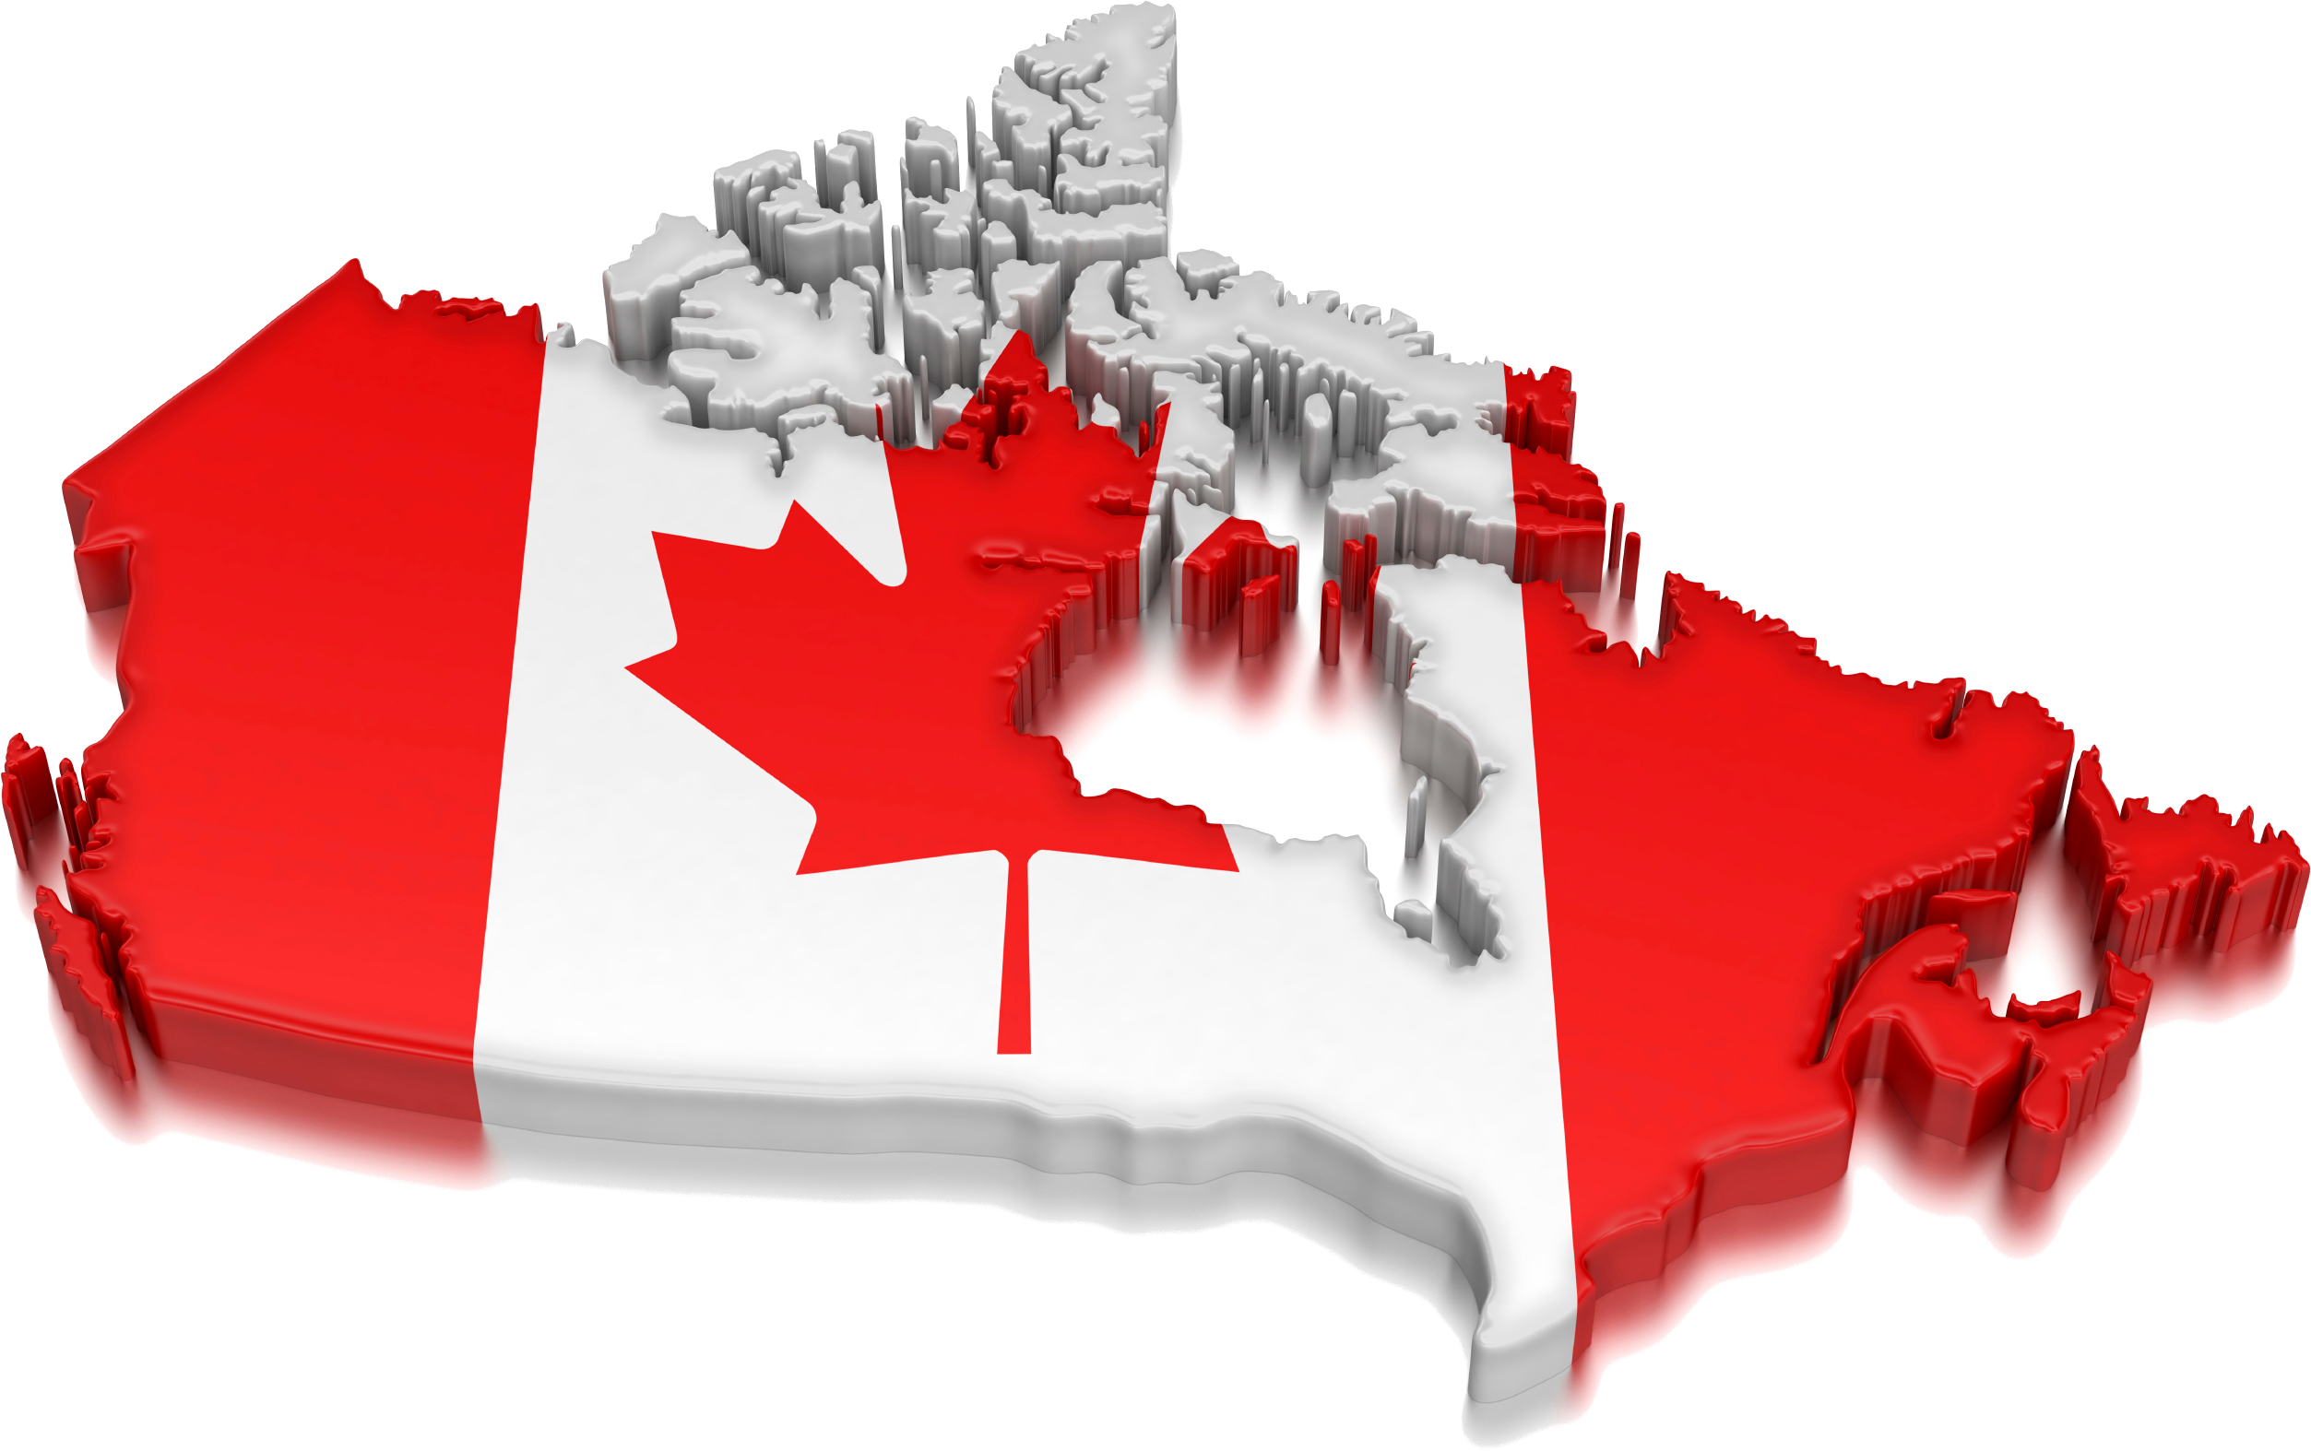
CANADA
Canada Map by KindPNG
Notes:
Let us look at how ideology has worked historically.
Beginning in the late 1800s, many First Nations children were removed from their homes and placed in remote church or state run residential boarding schools.
The idea behind this policy was the belief that Christianity and Western European culture (i.e., British and French) were superior.
The stated goal was to “remove the Indian from the child” by forcing these children to adopt the language, culture, religion, and values of the dominant group.
In recent years, it has come to light that many of the children were physically and sexually abused in the residential school system.
This ideology of cultural superiority constrained, marginalized, and destroyed Aboriginal communities. And the effects last to this day.

Slide 15
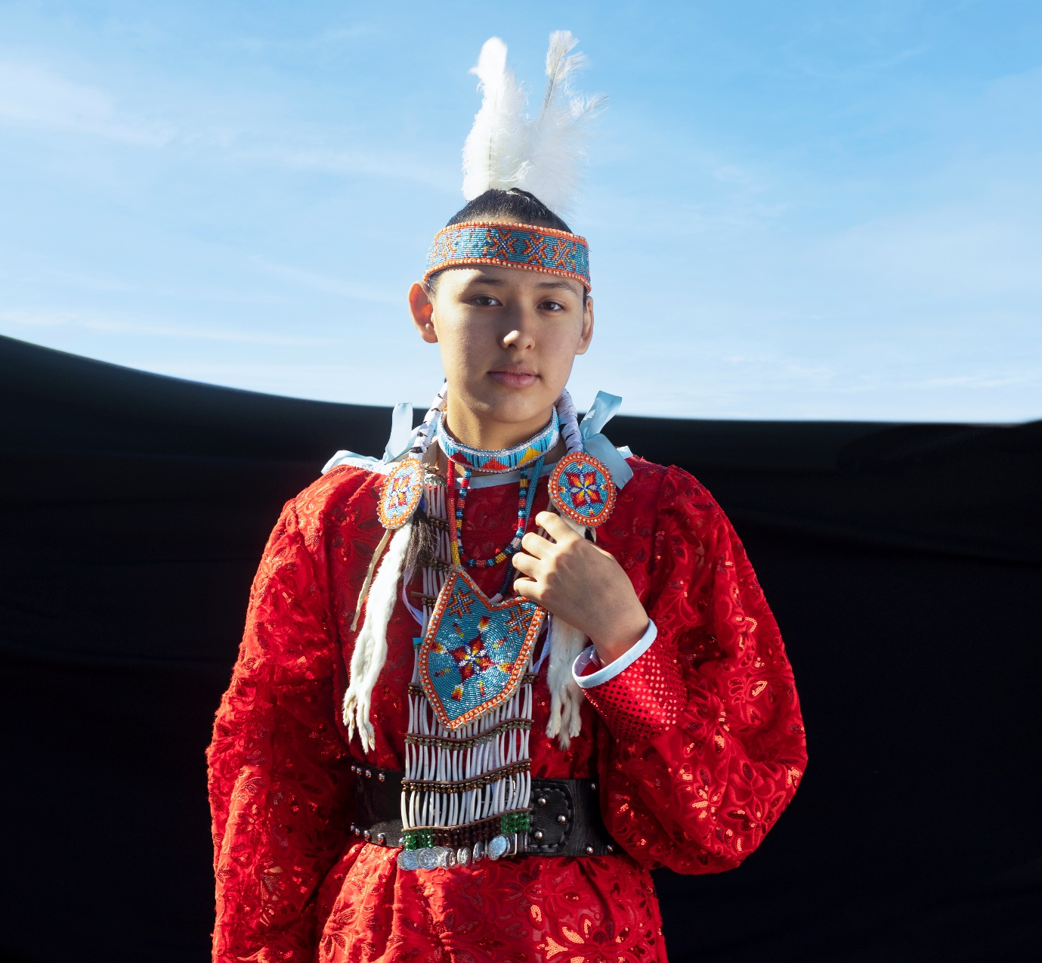
Indigenous PEOPLE OF CANADA
Before the arrival of Europeans, First Nations in what is now Canada were able to satisfy all their material and spiritual needs through the resources of the natural world around them.
Historians tend to group First Nations Peoples in Canada according to the six main geographic areas
They were :
Woodland First Nations
Iroquoian First Nations
Plains First Nations
Plateau First Nations
Pacific Coast First Nations
First Nations of the Mackenzie & Yukon River Basins
Tribe photo by freepik.com
Notes:
Before the arrival of Europeans, First Nations in what is now Canada were able to satisfy all their material and spiritual needs through the resources of the natural world around them.
Historians tend to group First Nations Peoples in Canada according to the six main geographic areas
They were :
Woodland First Nations
Iroquoian First Nations
Plains First Nations
Plateau First Nations
Pacific Coast First Nations
First Nations of the Mackenzie & Yukon River Basins

Slide 16

Indigenous or Aboriginal
There is no generally accepted universal definition of Indigenous Peoples in a global context.
Some countries refer to Indigenous Peoples as the people who were there first at contact. Others refer to Indigenous Peoples as the nomadic peoples within their borders. Some say Aboriginal Peoples.
Indian, Native, First Nations, Aboriginal, Aboriginal Peoples, Indigenous? Which one is it?
Dreamcatcher Photo By wirestock - freepik.com
Notes:
There is no generally accepted universal definition of Indigenous Peoples in a global context.
Some countries refer to Indigenous Peoples as the people who were there first at contact. Others refer to Indigenous Peoples as the nomadic peoples within their borders. Some say Aboriginal Peoples.
Indian, Native, First Nations, Aboriginal, Aboriginal Peoples, Indigenous? Which one is it?

Slide 17
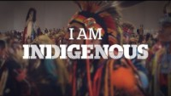
Notes:
What does, being Indigenous mean?
We asked, and you shared with us your experiences of being Indigenous.
To mark National Indigenous Peoples Day, we're sharing the profiles of 18 Indigenous leaders and change-makers.
You can access them here http://bit.ly/2sUQvc8
https://youtu.be/X-zwP6q1GkM

Slide 18

TREATY RIGHTS
First Nations peoples whose ancestors signed peace treaties with the colonial and Canadian governments have treaty rights. The treaties were signed in exchange for land to be enjoyed by mainstream Canadian society.
There are 11 treaties
No two treaties are identical.
The treaty rights of an individual treaty First Nation person will depend on the precise terms and conditions of the treaty that their First Nation government signed.
Treaty rights typically provide for reserve lands, annual payments, and hunting, trapping, gathering and fishing rights.
Artwork by Hi Profile is licensed under a CC BY-NC-SA 4.0 International License.

Slide 19
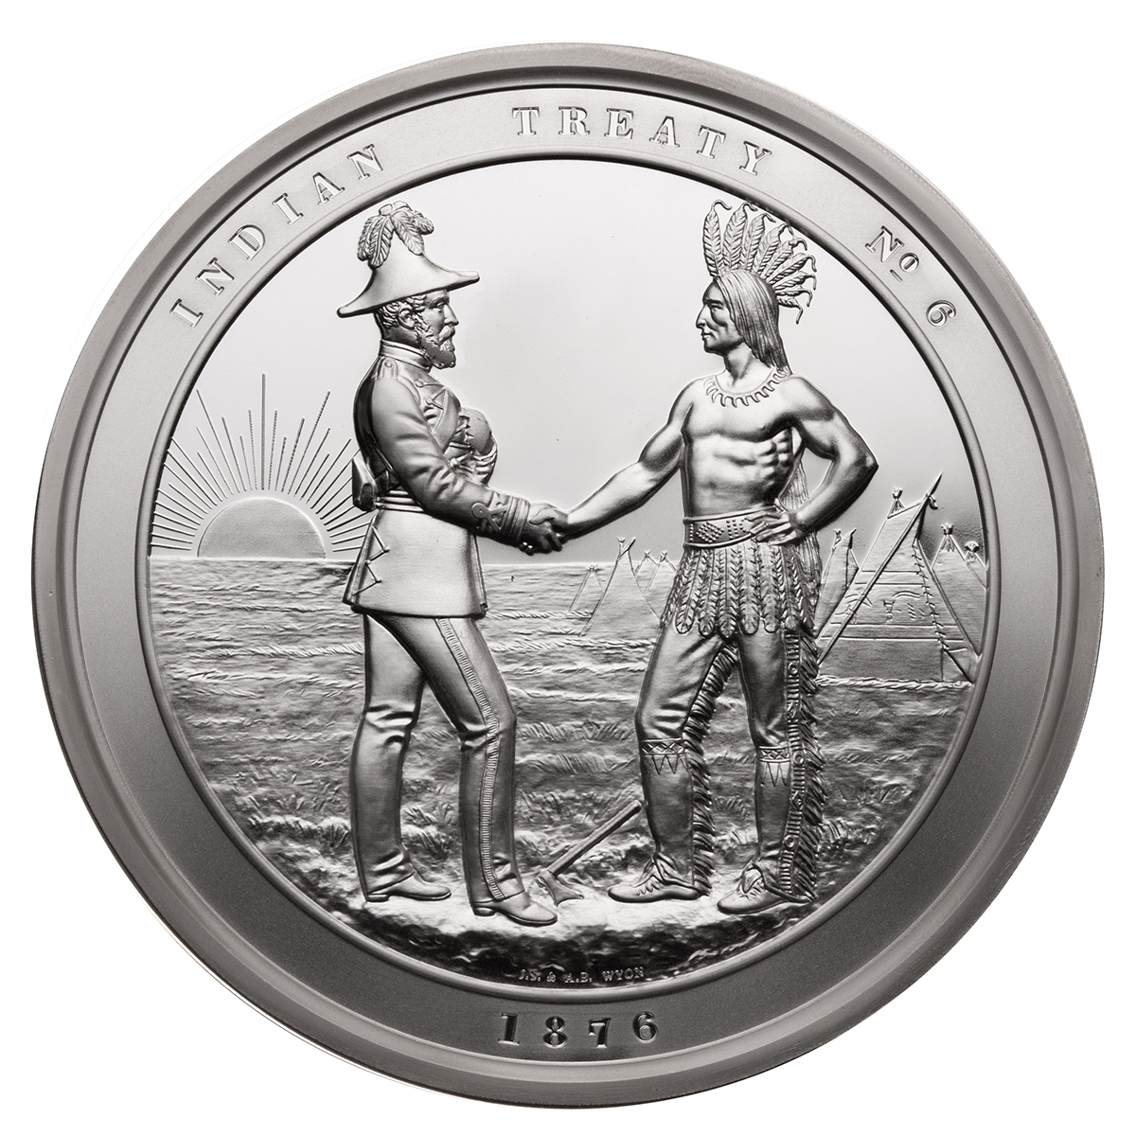
TREATIES AND TREATY RIGHTS
First Nations treaty members receive $2, $3 or $5 per year in treaty payments.
Treaty costs are small in comparison to the gifts enjoyed by Canada during colonial settlement, and the building of Canada. These gifts continue into present day.
There is a common misconception that treaties are offered by the Canadian government to be nice.
Treaties form a legal relationship between First Nations governments and our Canadian government.
In 1876, our Canadian government passed the Indian Act to put into law our federal government’s responsibilities to First Nations peoples and lands reserved for First Nations governments
Photo Canadian Coin by Canadian Mint

Slide 20
THE INDIAN ACT!
denied women status; introduced residential schools; created reserves; renamed individuals with European names
restricted First Nations from leaving reserve without permission; enforced enfranchisement of any First Nation admitted to university
could expropriate portions of reserves for roads, railways and other public works, as well as to move an entire reserve away from a municipality if it was deemed expedient;
could lease out uncultivated reserve lands to non-First Nations if the new leaseholder would use it for farming or pasture;
Forbids forming political organizations;
prohibited anyone, First Nation or non-First Nation, from soliciting funds for First Nation legal claims without special license from the Superintendent General.
prohibited the sale of alcohol to First Nations;
prohibited sale of ammunition to First Nations;
prohibited pool hall owners from allowing First Nations entrance;
imposed the "band council" system;
forbade First Nations from speaking their native language;
forbade First Nations from practicing their traditional religion;
forbade western First Nations from appearing in any public dance, show, exhibition, stampede or pageant wearing traditional regalia;
declared cultural ceremonies illegal;
denied First Nations the right to vote;
created permit system to control First Nations ability to sell products from farms;
is a piece of legislation created under the British rule for the purpose of subjugating one race - Aboriginal people.
https://www.ictinc.ca/blog/21-things-you-may-not-have-known-about-the-indian-act-

Slide 21

Notes:
https://youtu.be/BnfITZOIaO4

Slide 22
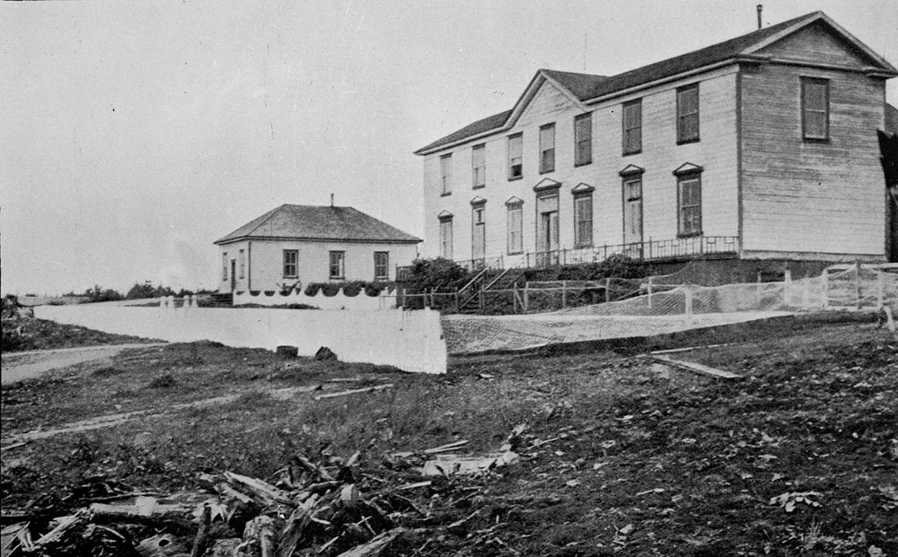
RESIDENTIAL SCHOOLS
The Indian residential school system was a network of mandatory boarding schools for Indigenous peoples.
The first residential school opened in 1828, and the last one closed in 1996.
The Canadian government operated Indian residential schools in partnership with the Anglican, Catholic, Methodist, and Presbyterian churches, among others.
The Canadian government was financially responsible for Indian residential schools.
It is estimated that over 150,000 Indian, Inuit, and Métis children were taken from their families
New classroom building of Kamloops Indian Residential School, Kamloops, British Columbia, circa 1950 (Library and Archives Canada) CC BY 2.0
Notes:
The Indian residential school system was a network of mandatory boarding schools for Indigenous peoples.
The first residential school opened in 1828, and the last one closed in 1996.
The Canadian government operated Indian residential schools in partnership with the Anglican, Catholic, Methodist, and Presbyterian churches, among others.
The Canadian government was financially responsible for Indian residential schools.
It is estimated that over 150,000 Indian, Inuit, and Métis children were taken from their families

Slide 23
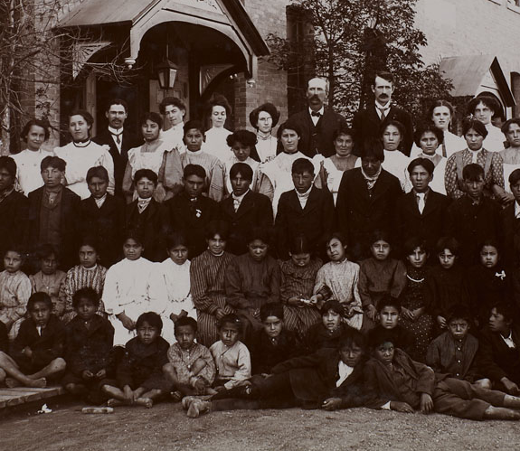
RESIDENTIAL SCHOOLS
The practice of taking Aboriginal children away from their own families and raising them in often brutal and abusive residential schools was to take the Indian out of the Child.
This was a form of cultural genocide. The idea was to bring Aboriginal people into mainstream of society, but the effect was that it isolated them further and caused generational harm
This policy continued for more than a century, finally ending 25 years ago.
Indian Residential School students and staff, Regina, Saskatchewan, 1908 (Library and Archives Canada) CC BY 2.0

Slide 24
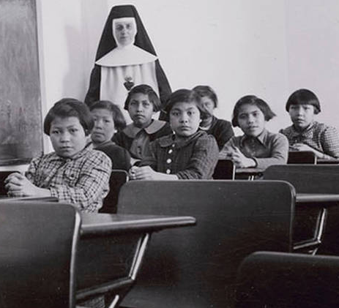
RESIDENTIAL SCHOOLS
Below are some of the documented ways that Indian residential school staff ensured students respected the rules:
Needles inserted into tongues for speaking their language
Leather strap used to hit on various areas of body
Beating with fists
Burning and scalding hands
Inflicting beatings until unconscious
Starvation
Shaming
Public beatings of naked children
Public strip search
Genital search
Sexual abuse
Locking in closets, cages, and basements
And this was all done in the name of religion
Cross Lake Indian Residential School in Cross Lake, Man., Feb, 1940 (Library and Archives Canada) CC BY 2.0
Notes:
Below are some of the documented ways that Indian residential school staff ensured students respected the rules:
Needles inserted into tongues for speaking their language
Leather strap used to hit on various areas of body
Beating with fists
Burning and scalding hands
Inflicting beatings until unconscious
Starvation
Shaming
Public beatings of naked children
Public strip search
Genital search
Sexual abuse
Locking in closets, cages, and basements
And this was all done in the name of religion

Slide 25
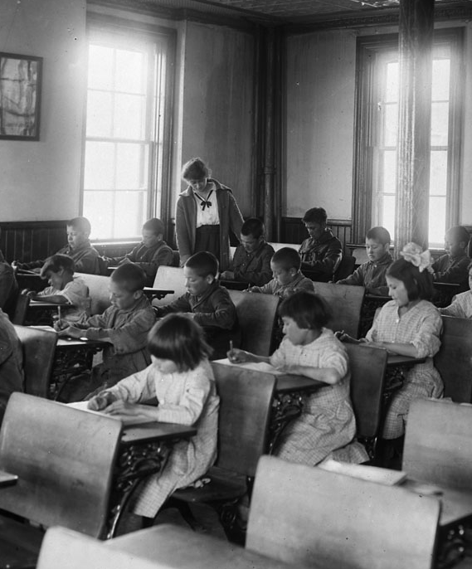
RESIDENTIAL SCHOOLS
In 1884, amendments to the Indian Act, 1876 were adopted and provided for the creation of Indian residential schools.
The Indian residential schools in Canada were predominately funded and operated by the Government of Canada and by provincial governments or by the various religious groups.
In 1920, amendments to the Indian Act make it mandatory for every Indian child between the ages of 7 &16 to attend the schools.
In 1933, legal guardianship of the Indian children attending Indian residential school was assumed by the principals of those Indian residential schools, upon the forcible surrender of legal custody by parents.
Interior of classroom, Indian Industrial School, Brandon, Manitoba, 1946 (Library and Archives Canada) CC BY 2.0
Notes:
In 1884, amendments to the Indian Act, 1876 were adopted and provided for the creation of Indian residential schools.
The Indian residential schools in Canada were predominately funded and operated by the Government of Canada and by provincial governments or by the various religious groups.
In 1920, amendments to the Indian Act make it mandatory for every Indian child between the ages of 7 &16 to attend the schools.
In 1933, legal guardianship of the Indian children attending Indian residential school was assumed by the principals of those Indian residential schools, upon the forcible surrender of legal custody by parents.

Slide 26
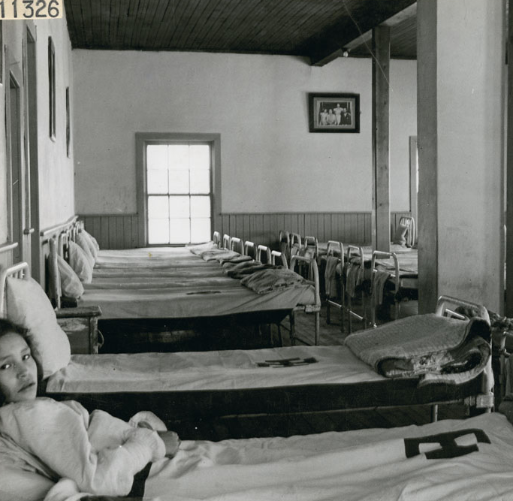
RESIDENTIAL SCHOOLS
They were forced to abandon their language, cultural beliefs, and way of life, and mandated to adopt the European languages of English or French, foreign religious denominations, and new habits.
The following is a list of some of the unpleasant traumatic experiences lived by former students that have been documented:
Forbidden to speak their Aboriginal languages, Required to speak English or French, Required to adopt religious denomination of the school, Forced style of prayer consistent with school denomination, Forced haircut, or shaved head, Use of toxic chemical to clean children’s hair and skin, Forced to wear uniform as designed by the school, Forced to shower, no access to bath tubs, Lack of nutritious diet, Insufficient quantities of food, Served spoiled food, Segregation based on gender: brothers and sisters no contact, Sexual assault, Forced abortions, Electrical shock 6, Force-feeding of own vomit when sick, Exposure to freezing outside temperatures with improper clothing, Withholding of medical attention, Exposure to contagious illness: students with tuberculosis not segregated, Forced labour in unsafe work environments, Vilification of cultural traditions, Use of racist language to address students, Withholding presents and letters from family
Two girls resting in the dormitory at All Saints Indian Residential School, (Anglican Mission School), Lac La Ronge, Saskatchewan, March 1945 (Library and Archives Canada) CC BY 2.0
Notes:
They were forced to abandon their language, cultural beliefs, and way of life, and mandated to adopt the European languages of English or French, foreign religious denominations, and new habits.
Warning. The content is disturbing and may cause trauma for some individuals
The following is a list of some of the unpleasant traumatic experiences lived by former students that have been documented:
•Forbidden to speak their Aboriginal languages
•Required to speak English or French
•Required to adopt religious denomination of the school
•Forced style of prayer consistent with school denomination
•Forced haircut, or shaved head
•Use of toxic chemical to clean children’s hair and skin
•Forced to wear uniform as designed by the school
•Forced to shower, no access to bath tubs
•Lack of nutritious diet
•Insufficient quantities of food
•Served spoiled food
•Segregation based on gender: brothers and sisters no contact
•Sexual assault
•Forced abortions
•Electrical shock 6
•Force-feeding of own vomit when sick
•Exposure to freezing outside temperatures with improper clothing
•Withholding of medical attention
•Exposure to contagious illness: students with tuberculosis not segregated
•Forced labour in unsafe work environments
•Vilification of cultural traditions
•Use of racist language to address students
•Withholding presents and letters from family

Slide 27

THE 60’s Scoop
The 60s Scoop refers to the adoption of First Nation/Metis children in Canada between the years of 1960 and the mid 1980’s.
Thousands of Indigenous children were removed from their homes and placed with non-Indigenous families. Those affected lost all contact with their children and families. They also lost critical connection to their language, culture and identity.
This period is unique in the annals of adoption. This phenomenon, coined the “60’s Scoop”, is so named because the highest numbers of adoptions took place in the decade of the 1960s and because, in many instances, children were literally scooped from their homes and communities without the knowledge or consent of families and bands
Image FAVPNG
Notes:
The 60s Scoop refers to the adoption of First Nation/Metis children in Canada between the years of 1960 and the mid 1980’s.
Thousands of Indigenous children were removed from their homes and placed with non-Indigenous families. Those affected lost all contact with their children and families. They also lost critical connection to their language, culture and identity.
This period is unique in the annals of adoption. This phenomenon, coined the “60’s Scoop”, is so named because the highest numbers of adoptions took place in the decade of the 1960s and because, in many instances, children were literally scooped from their homes and communities without the knowledge or consent of families and bands
There is a class action lawsuit launched in
For more info go to https://sixtiesscoopsettlement.info/

Slide 28
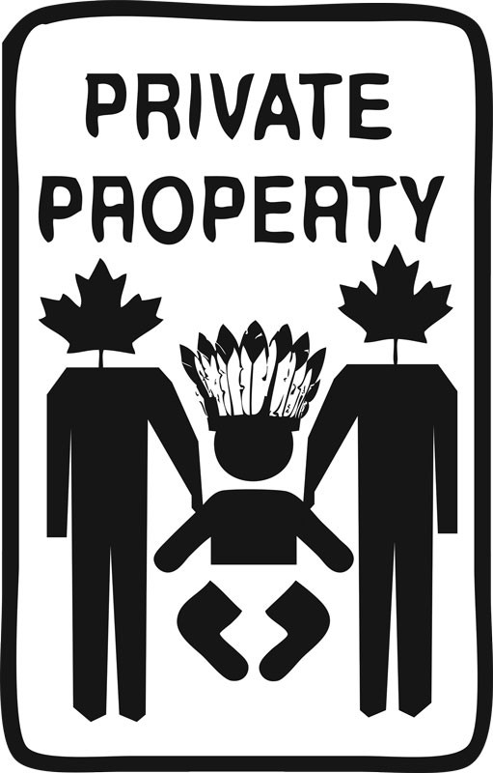
THE Millennial Scoop
The Millennial Scoop was coined to describe the alarming rate at which Indigenous children continue to be brought into the child welfare system and spans the early 1980s to today.
Indigenous kids are still being taken from their parents.
Most Canadians are aware of the horror of residential schools, but many don’t realize this genocidal system continues today, just in a different way—through the foster care system, where, across the country, Indigenous youth are horrifically overrepresented.
For example, in B.C., 63 percent of youth in foster care are Indigenous; in Manitoba, it’s 91 percent.
In Canada, 52.2% of children in foster care are Indigenous, but account for only 7.7% of the child population
Image By Tania Willard – briarpatch Magazine
Notes:
The Millennial Scoop was coined to describe the alarming rate at which Indigenous children continue to be brought into the child welfare system and spans the early 1980s to today.
Indigenous kids are still being taken from their parents.
Most Canadians are aware of the horror of residential schools, but many don’t realize this genocidal system continues today, just in a different way—through the foster care system, where, across the country, Indigenous youth are horrifically overrepresented.
For example, in B.C., 63 percent of youth in foster care are Indigenous; in Manitoba, it’s 91 percent.
In Canada, 52.2% of children in foster care are Indigenous, but account for only 7.7% of the child population
The child welfare experience is a traumatizing to ANYONE. Social workers of the sixties scoop and Indian Agents appointed by the federal government removed Aboriginal children from their families. Aboriginal families involved with this agency were and are subjected to practices that perpetuate colonial policies meant to assimilate the First Peoples of Turtle Island.

Slide 29
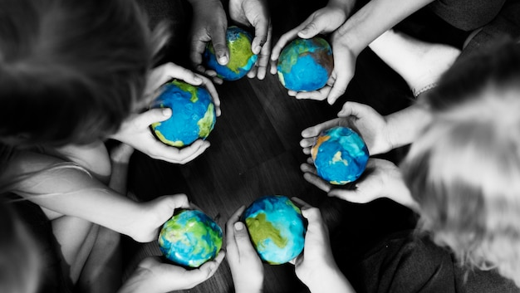
BREAKOUT GROUPS
By rawpixel.com - freepik.com
Notes:
Break into small groups to do group work
Can you think of any reasonable explanation to justify the treatment of Aboriginal Peoples
What can be done to make meaningful change for our Canadian Society
After 10-15 minutes each group will have 1 -2 minutes to present back to the class on what makes a good working group

Slide 30

BREAK
Photo by Nathan Dumlao on Unsplash
Notes:
15 Minute Break
This slide can be moved to where you have your class break(s)

Slide 31


ATTENDANCE
ATTENDANCE MATTERS
Image by pch.vector - freepik.com
Notes:
This attendance slide can be moved to wherever in your class that you take attendance.
Usually attendance is taken around class breaks, or at the beginning or at the end of class.

Slide 32
Truth and Reconciliation
In order to redress the legacy of residential schools and advance the process of Canadian reconciliation, the Truth and Reconciliation Commission made 94 calls to action in the following areas
Child welfare
Education
Health
Justice
Reconciliation
Canadian Governments and the United nations declaration on the rights of indigenous People
Equity for Aboriginal People in the Legal System
National Council for Reconciliation
Professional Development and Training for Public Servants
Church Apologies and Reconciliation
Education for reconciliation
Aboriginal spiritual beliefs and practices developed in collaboration with Aboriginal Elders.
Youth Programs
Museums and Archives
Missing Children and Burial Information
National Centre for Truth and Reconciliation

Slide 33
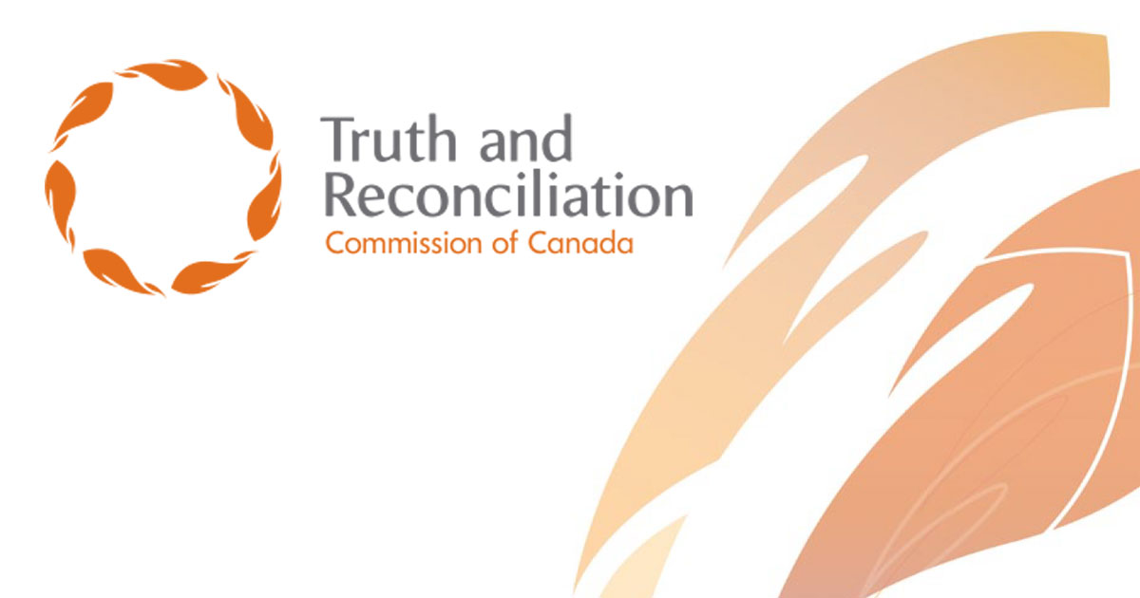
Truth and Reconciliation
The Commission was officially established on June 1, 2008 with the purpose of documenting the history and lasting impacts of the Canadian Indian residential school system on Indigenous students and their families.
It provided residential school survivors an opportunity to share their experiences during public and private meetings held across the country
Truth and Reconciliation Commission of Canada Logo Public Domain
Notes:
The Commission was officially established on June 1, 2008 with the purpose of documenting the history and lasting impacts of the Canadian Indian residential school system on Indigenous students and their families.
It provided residential school survivors an opportunity to share their experiences during public and private meetings held across the country

Slide 34
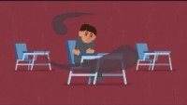
Notes:
https://youtu.be/2zuRQmwaREY

Slide 35
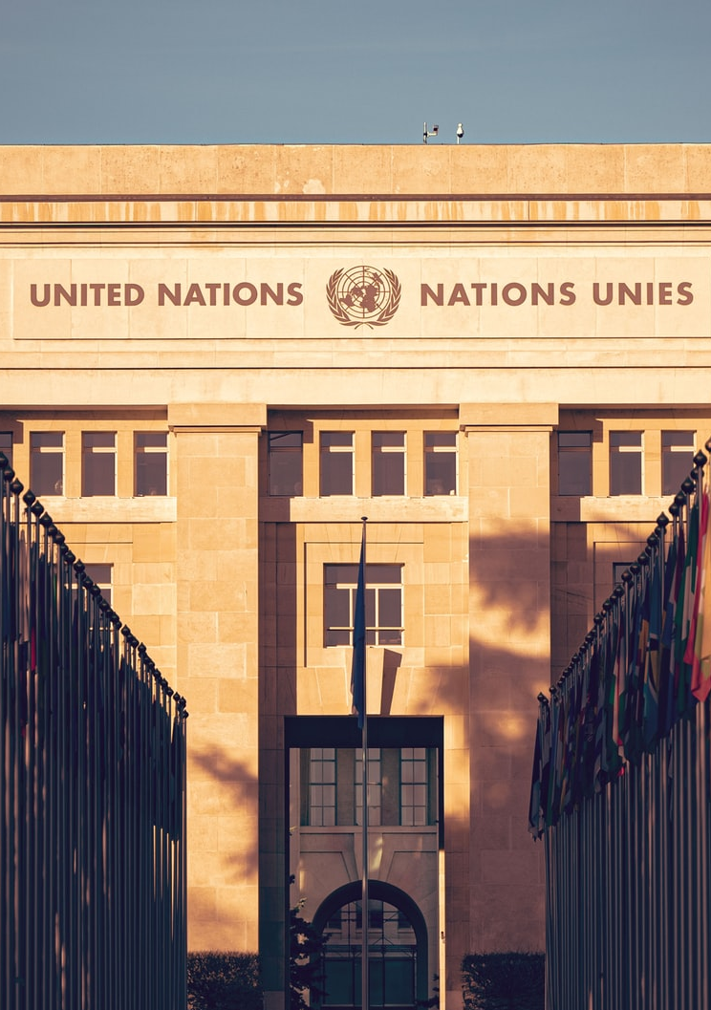
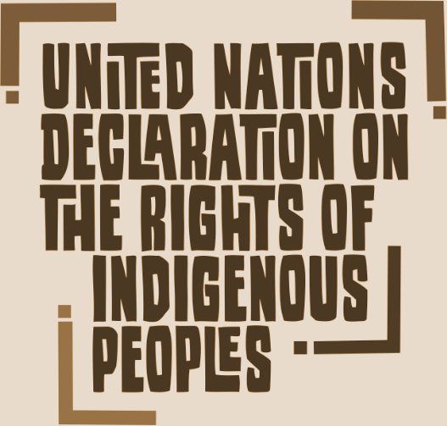

UN DECLARATION (UNDRIP)
The United Nations Declaration on the Rights of Indigenous Peoples (UNDRIP) is an international instrument adopted by the United Nations on September 13, 2007, to enshrine (according to Article 43) the rights that “constitute the minimum standards for the survival, dignity and well-being of the indigenous peoples of the world.”
The UNDRIP was adopted by 144 countries, with 11 abstentions and 4 countries voting against it. These four countries were Canada, the USA, New Zealand, and Australia. Since 2009 Australia and New Zealand have reversed their positions and now support the Declaration, while the United States and Canada have announced that they will revise their positions, yet nothing has changed yet.
Canada must see UNDRIP as an occasion and opportunity to do better by Indigenous peoples
Photo by Jonathan Ansel Moy de Vitry on Unsplash
UNDRIP DOCUMENT
Notes:
The United Nations Declaration on the Rights of Indigenous Peoples (UNDRIP) is an international instrument adopted by the United Nations on September 13, 2007, to enshrine (according to Article 43) the rights that “constitute the minimum standards for the survival, dignity and well-being of the indigenous peoples of the world.”
The UNDRIP was adopted by 144 countries, with 11 abstentions and 4 countries voting against it. These four countries were Canada, the USA, New Zealand, and Australia. Since 2009 Australia and New Zealand have reversed their positions and now support the Declaration, while the United States and Canada have announced that they will revise their positions yet nothing has changed yet.

Slide 36

Imagine Equality
Ask yourself, if there was equality, what would I see, hear and feel around me:
In society
At work
In the home
In the media
Among our leaders
Image by Yvette W from Pixabay
Notes:
Ask yourself, if there was equality, what would I see, hear and feel around me:
In society
At work
In the home
In the media
Among our leaders

Slide 37
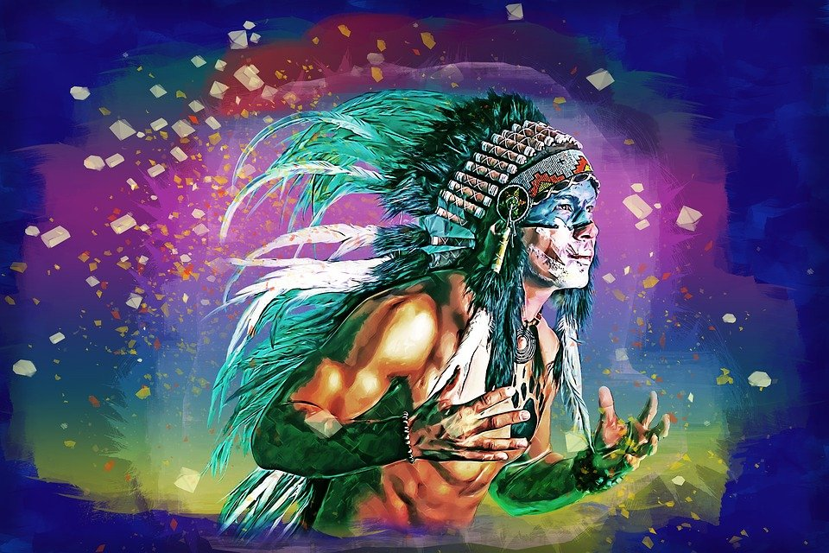
QUESTIONS
Image by Brigitte Werner from Pixabay
Notes:
You may have learned that First Nations people were the original inhabitants of Canada and have been for thousands of years.
Do you think this image represents a Canadian ?
What about the contribution of Black people to Canada
In spite of this knowledge, you would probably look out for a white Canadian.

